Slide 1
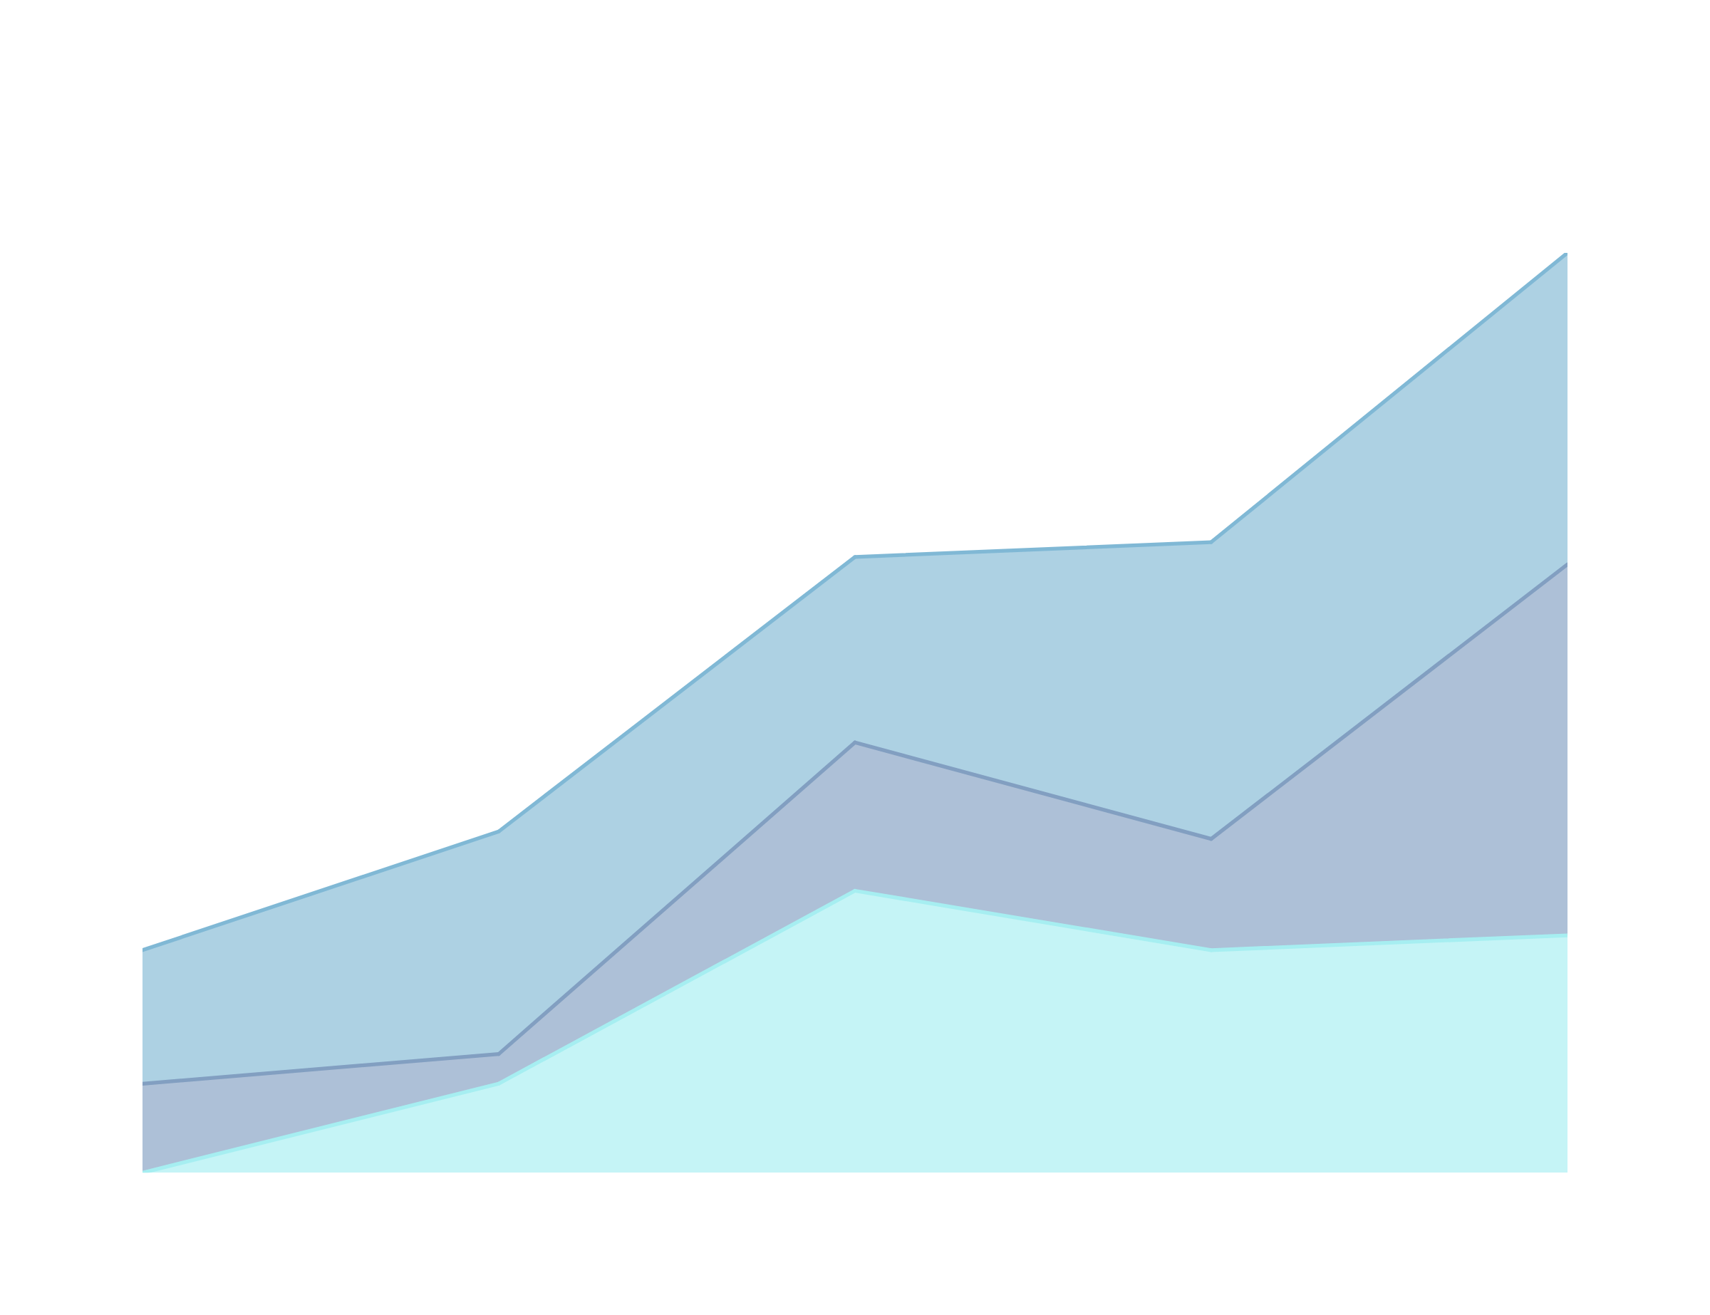
ENZO WÜRTELE - DATA ANALYST FOR VS GROUP COMPANY
THE CORRELATION OF PROFIT SALES AND DISCOUNTS
22-01-2025
1

Slide 2
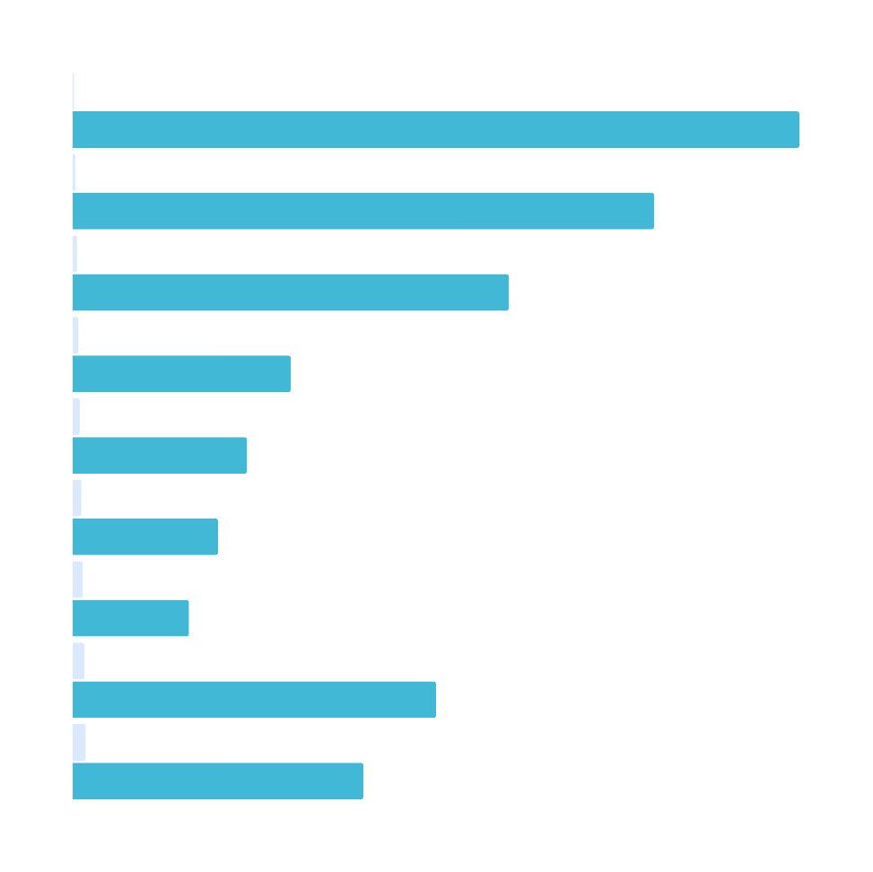
AGENDA
MY DATABASE
KEY DATA AND INSIGHTS
Low Profits Despite High Sales
Why Are We Losing Profit?
Discount-Profit Relationship
Clustering Analysis (KMeans)
KPIs for Review
Conclusion
2

Slide 3
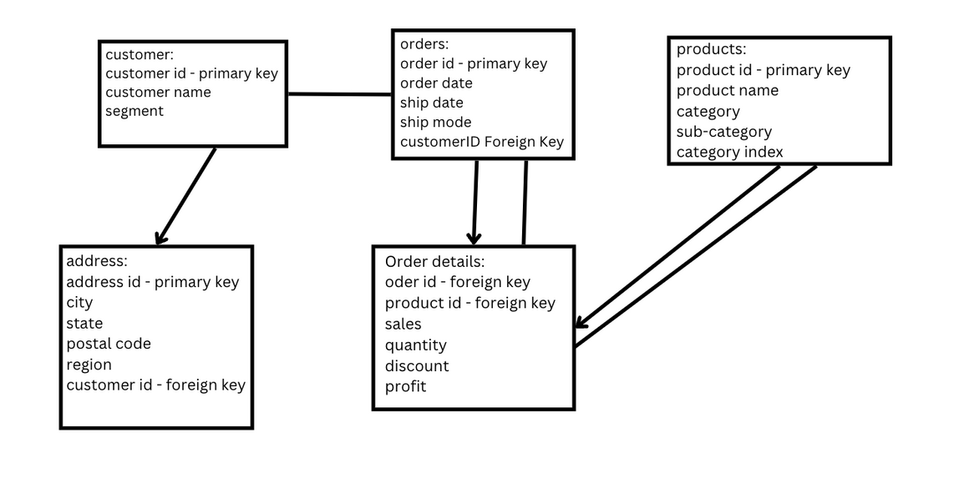
My Database Structure
3

Slide 4

KEY DATA AND INSIGHTS
Important data to understand for the rest of the powerpoint
4

Slide 5
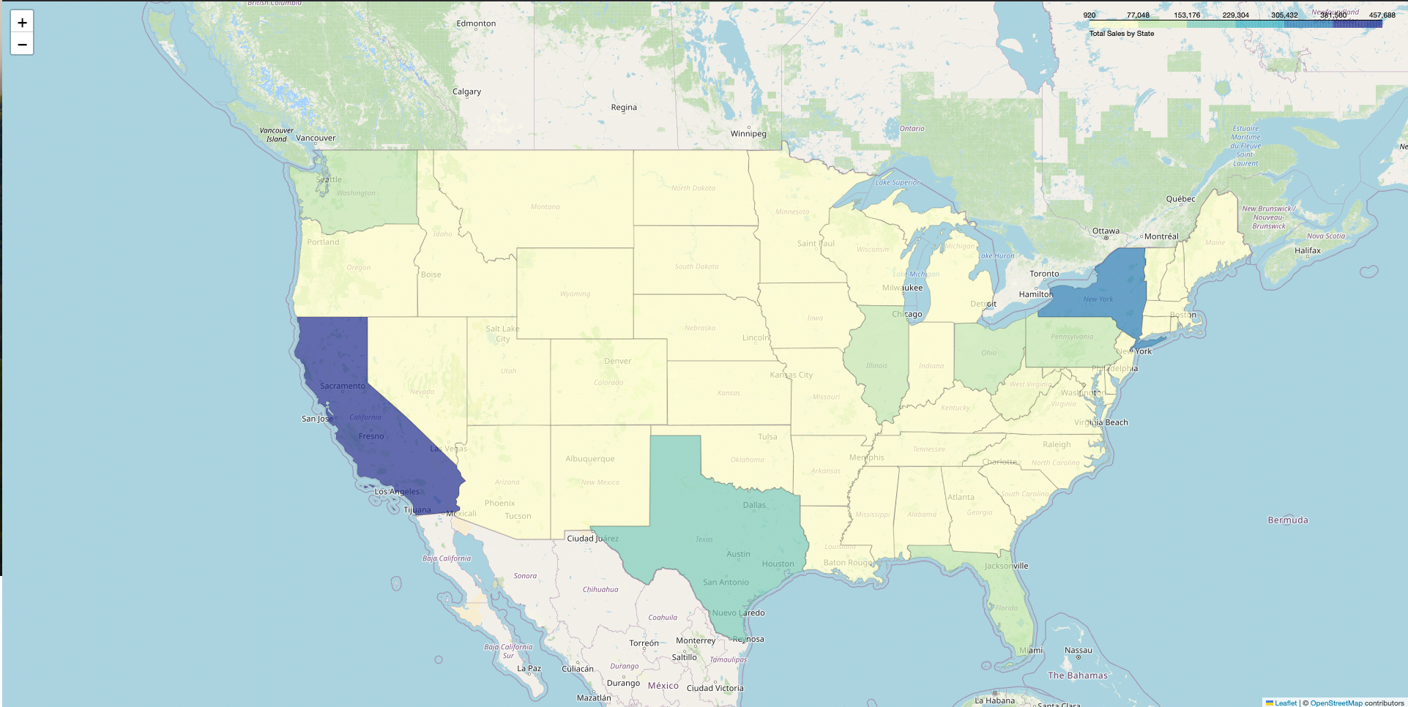
TOTAL SALES OF STATES
5

Slide 6
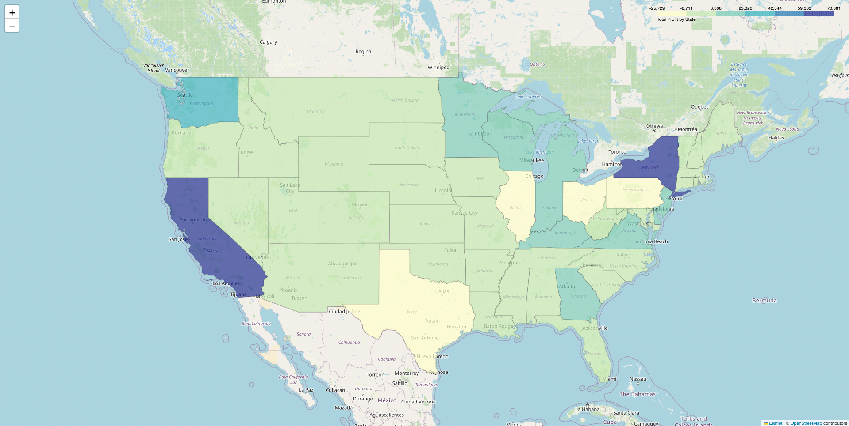
TOTAL PROFIT OF STATES
6

Slide 7
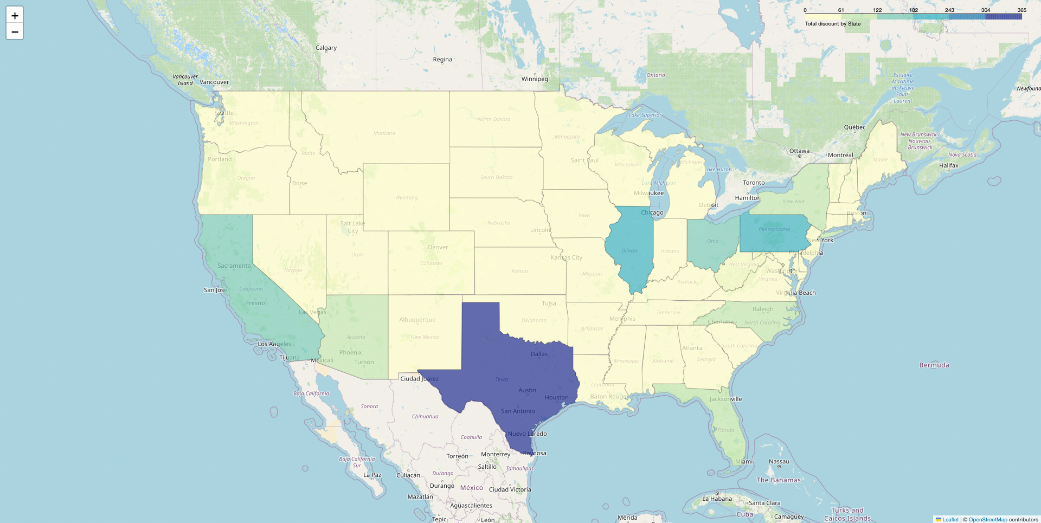
TOTAL DISCOUNT OF STATES
7

Slide 8
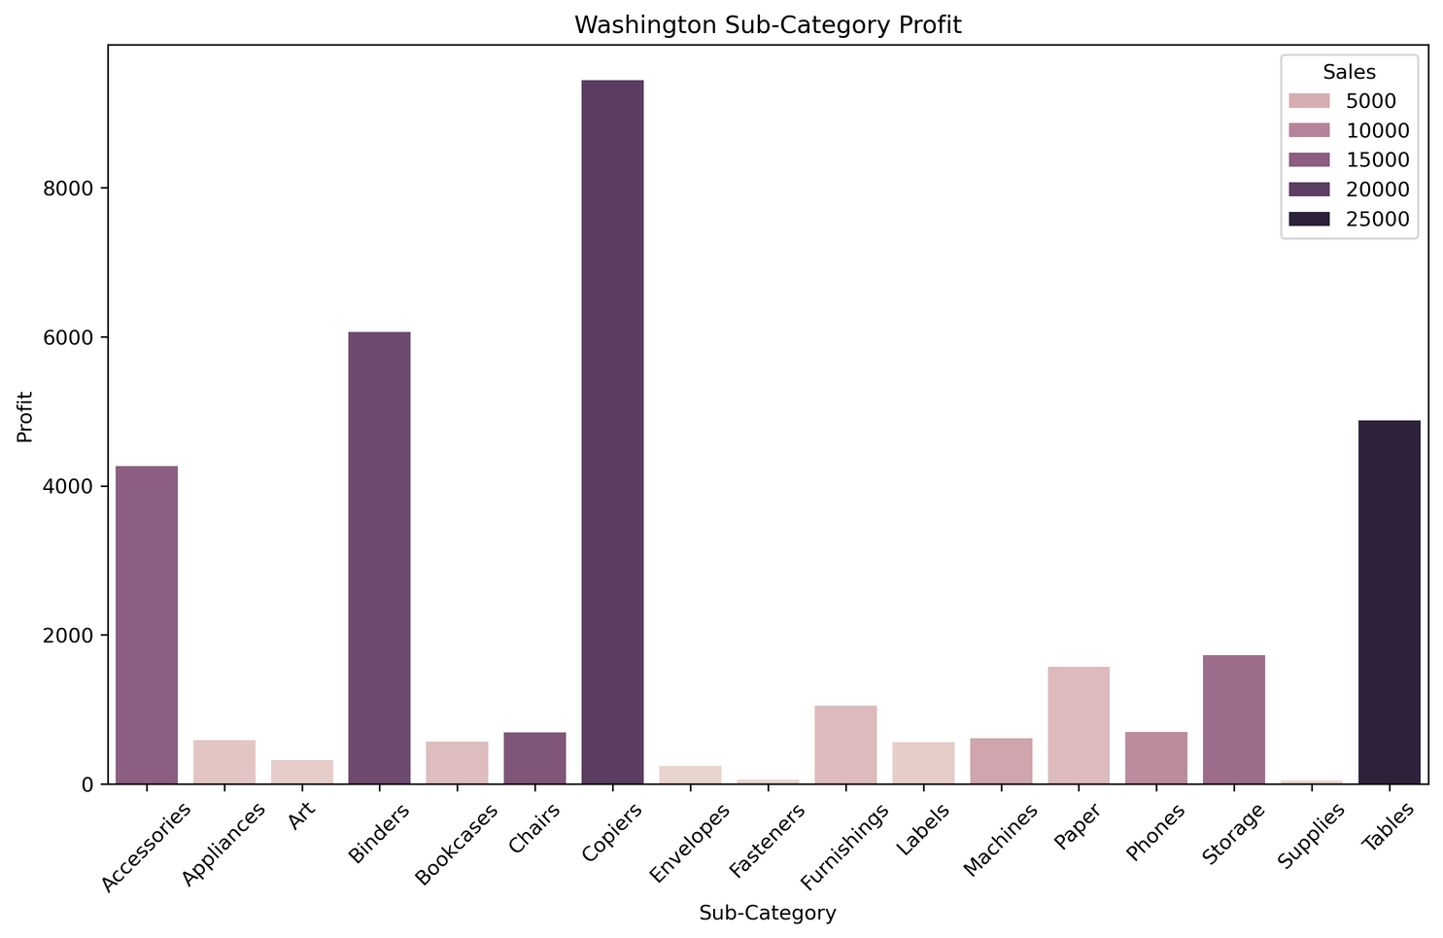
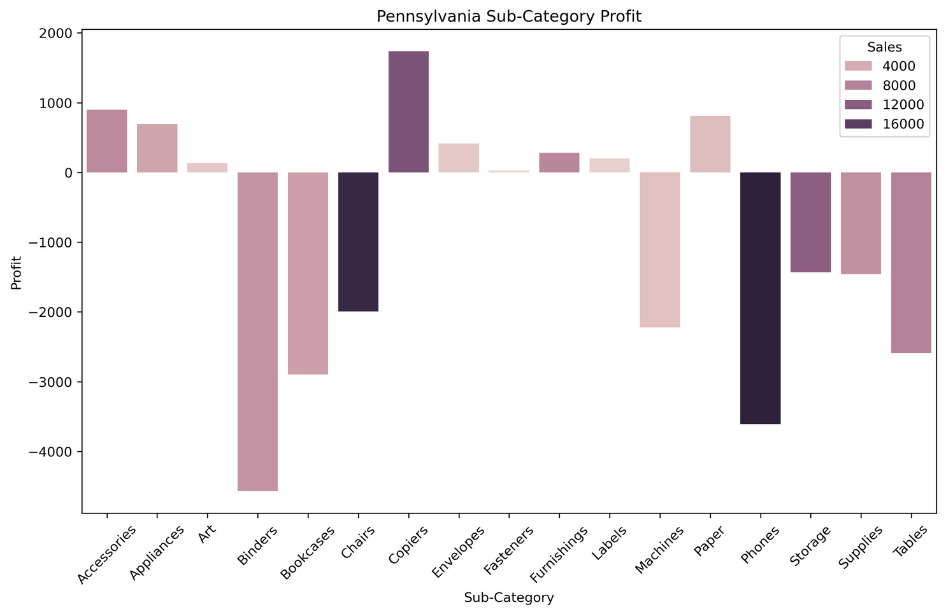
LOW PROFIT DESPITE HIGH SALES
Washington vs Pennsylvania
8

Slide 9
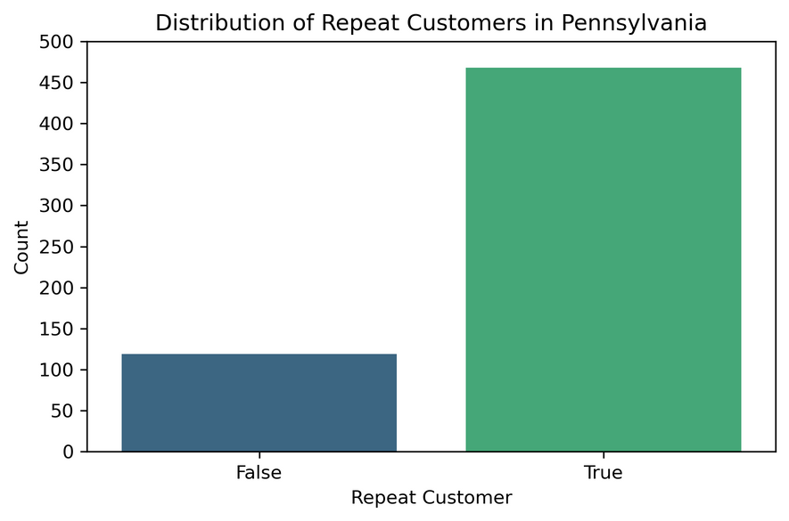
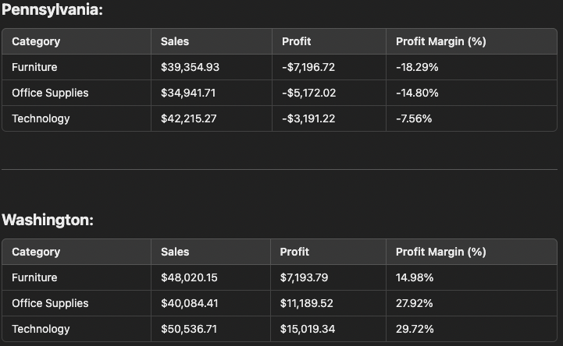
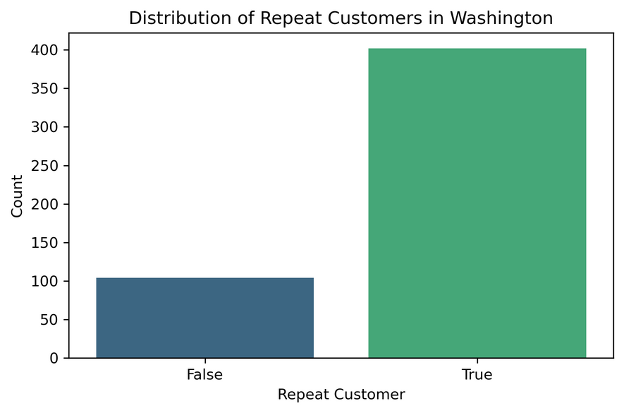
WHY PICK WASHINGTON AND PENNSYLVANIA?
9

Slide 10
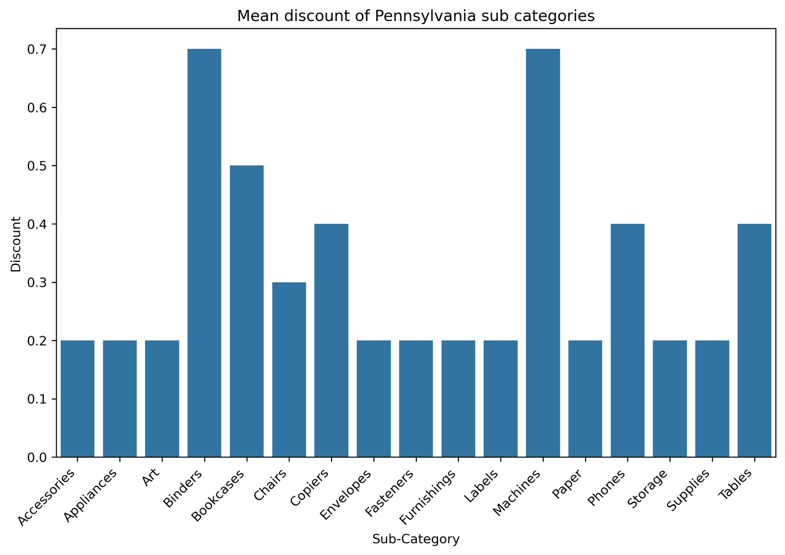
WHY ARE WE LOSING PROFIT?
10

Slide 11
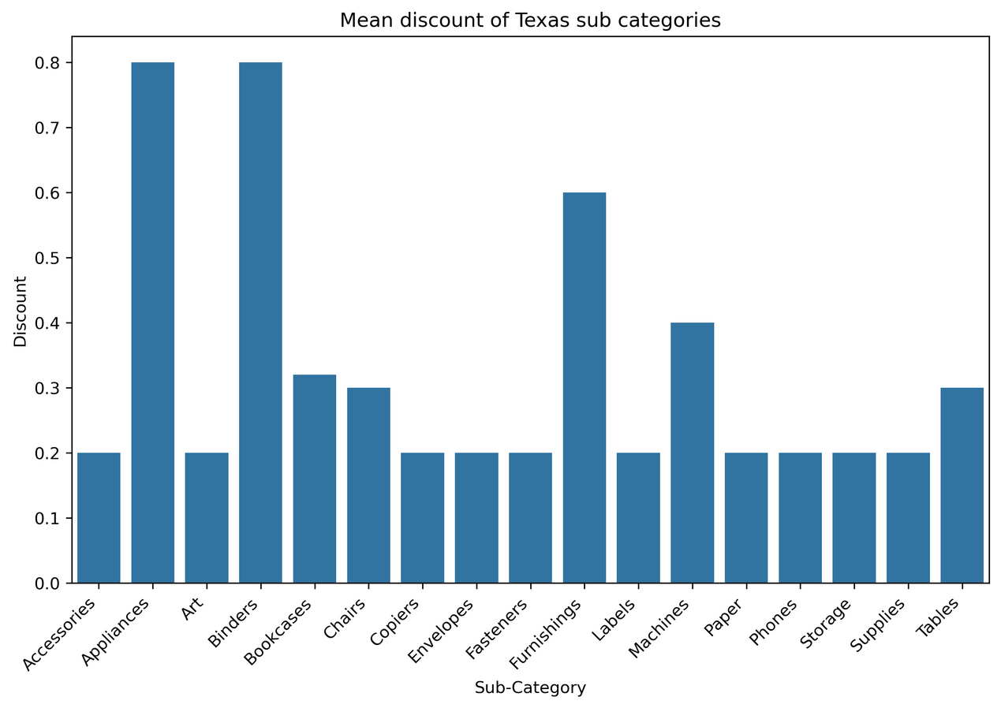
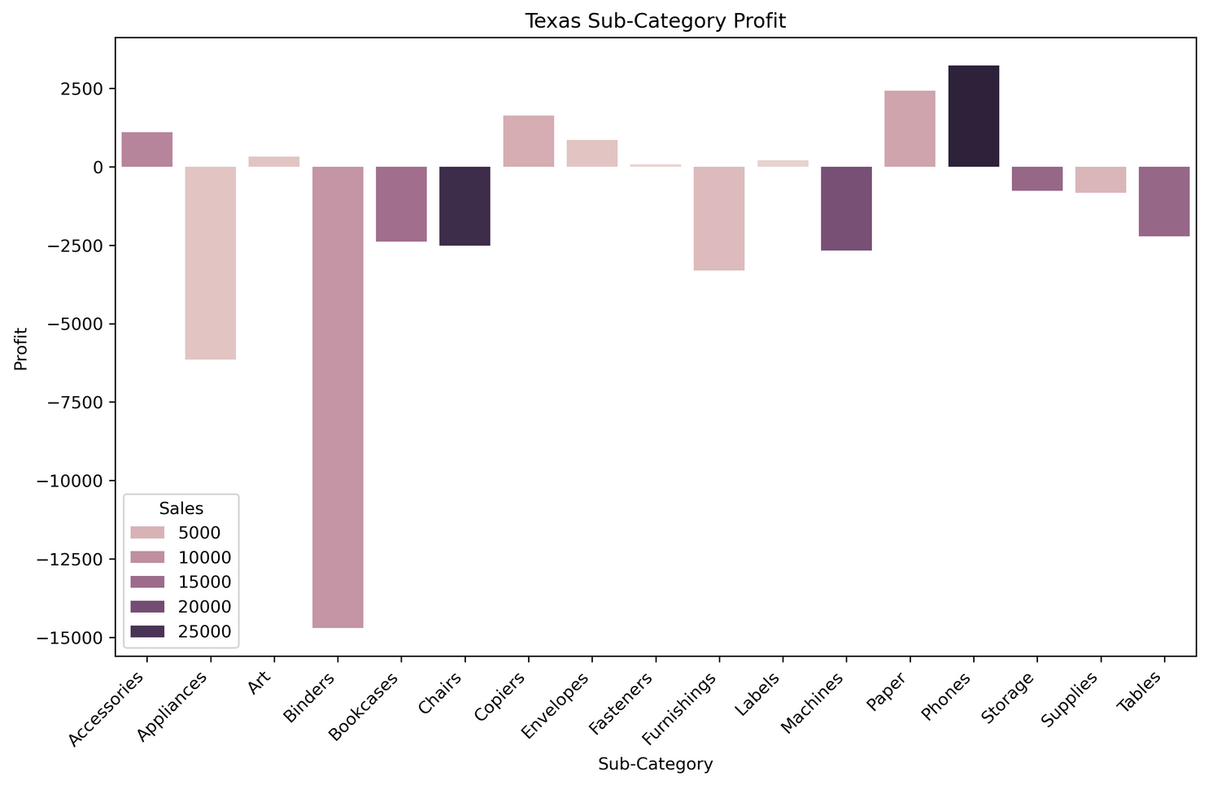
REPEATED RESULTS FOR OTHER LOW PROFIT STATES
11

Slide 12
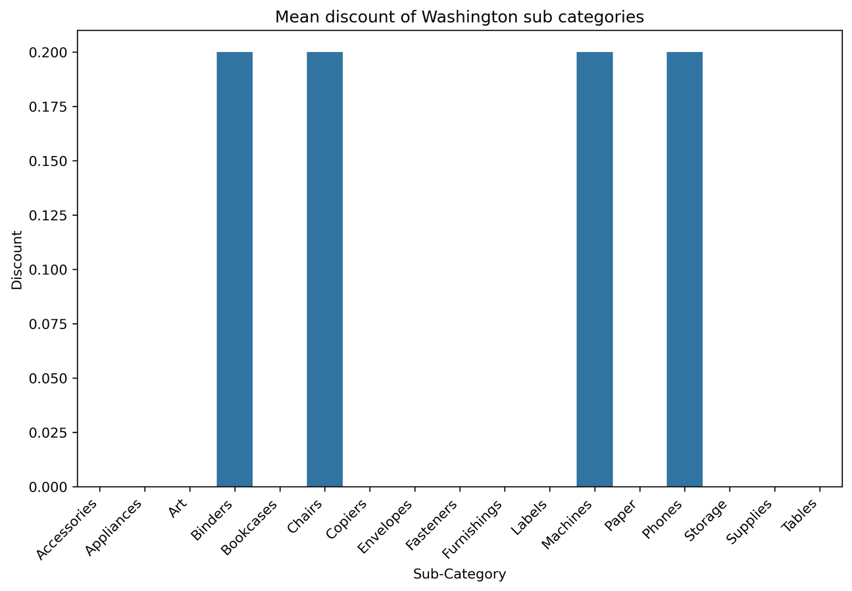
HOW DOES WASHINGTON LOOK COMPARATIVELY?
12

Slide 13
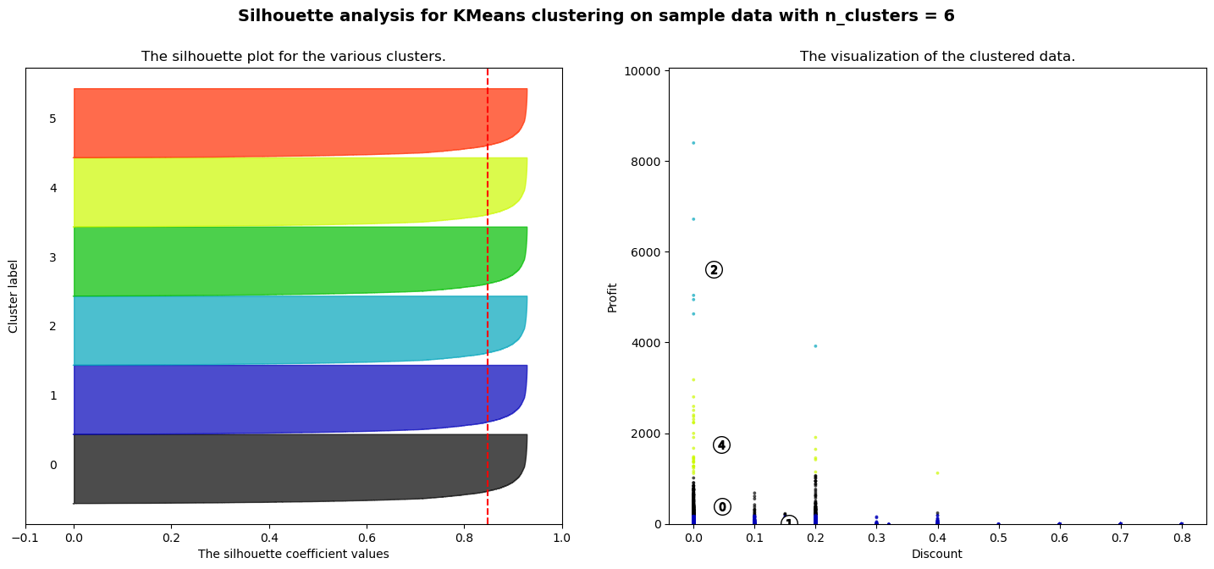
CLUSTERING ANALYSIS (KMEANS)
silhouette score = 0.84
13

Slide 14
KPI
Definition
Tracks how discounts influence profit margins across product categories, focusing on identifying the optimal discount level to maximize profitability while maintaining sales growth.
Objective
To reduce the negative impact of excessive discounts on high-margin products, ensuring profitability while driving sales.
14

Slide 15
KPI AIM AND PLANS
Target
Maintain an average profit margin reduction of less than 10% due to discounts across all categories.
Action Plan
Reevaluate discount strategies for high-margin products.
Implement dynamic pricing or tiered discounting based on profitability thresholds.
Monitor category-specific profit margins and adjust discount policies accordingly.
15

Slide 16
Conclusion
Entering the market presents an opportunity to learn from the challenges faced by competitors. By avoiding excessive discounting and focusing on strategic pricing for high-margin products, our company can establish a profitable foothold. Leveraging data-driven insights and efficient management practices will position us for sustainable growth and competitive success.
16

